Slide 1
Developing/Testing OpenGL on a LM/VM/Lectura/CS Labs

Slide 2
Overview
Repositories
OpenGL on a Local Machine/Virtual Machine
OpenGL on Lectura via PuTTY/Xming
OpenGL on Lectura via ssh
OpenGL on a CS Lab Machine (i.e. GS 930) via ssh

Slide 3

Repositories
They make your life easier!
Project content is organized, available, and portable across multiple platforms.
Plug-ins are available for IDEs.
References/Tutorials:
http://rogerdudler.github.io/git-guide/
https://www.atlassian.com/git/tutorials/

Slide 4
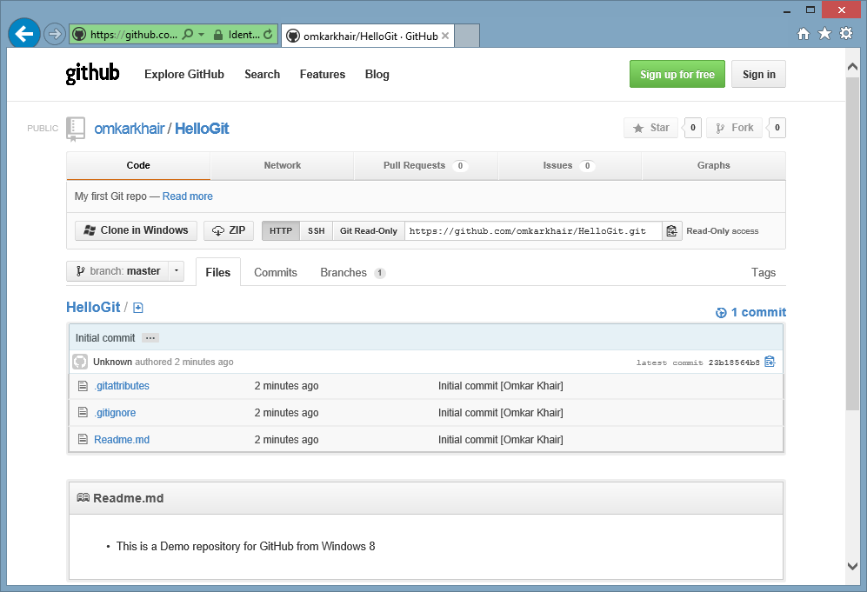

Repositories

Slide 5
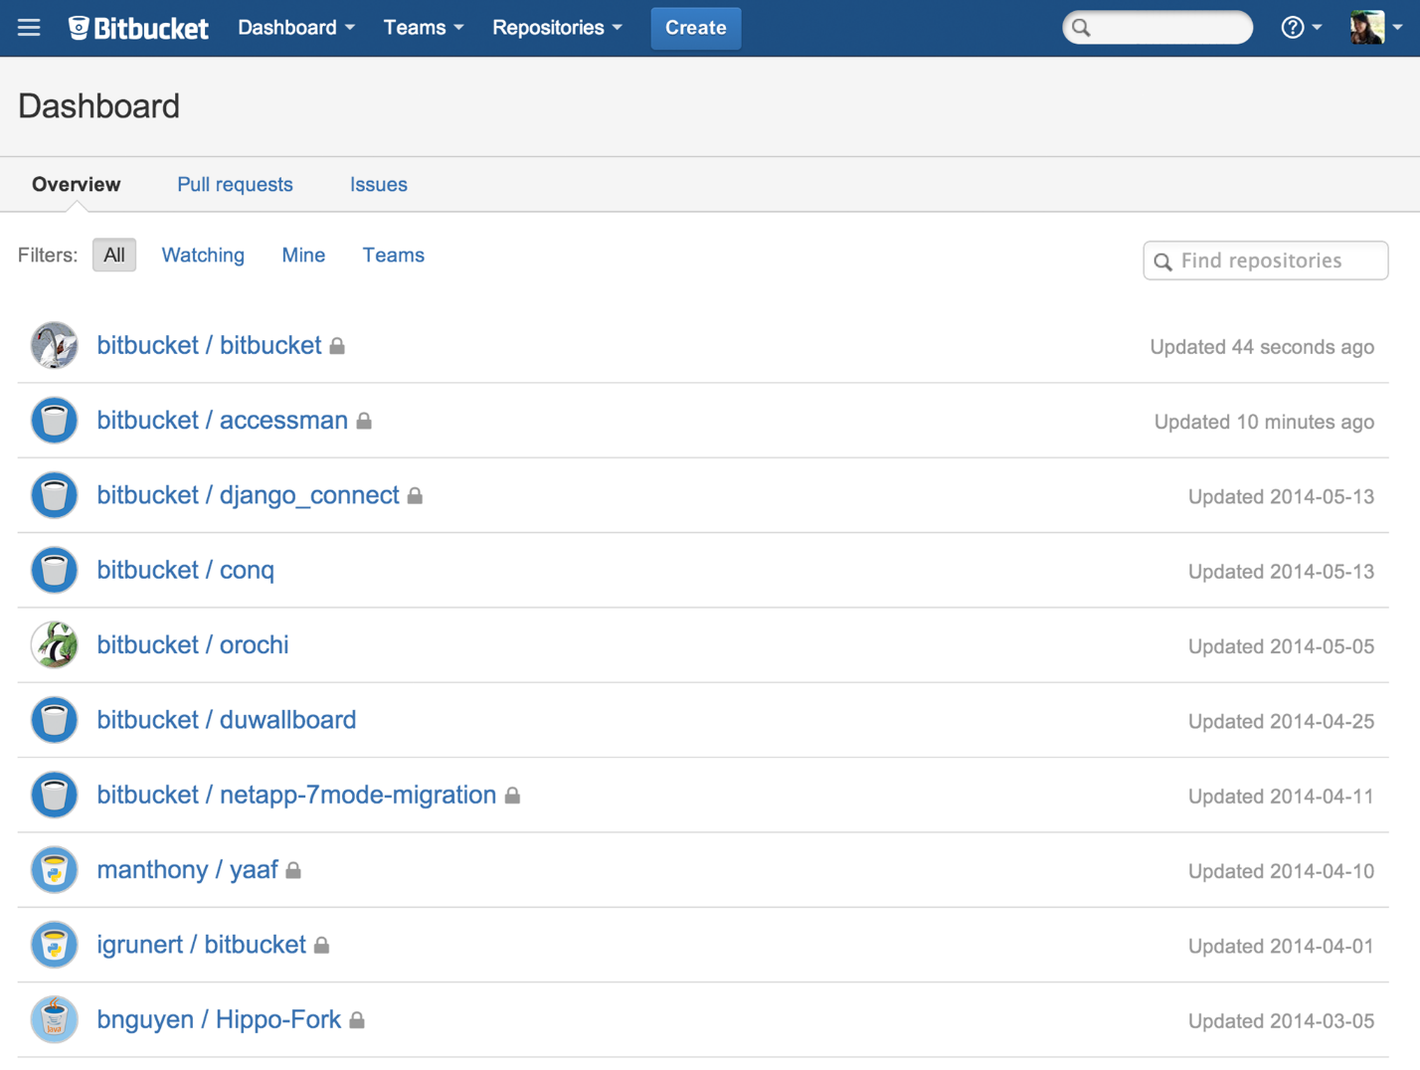

Repositories
Note: Free unlimited private code repositories!

Slide 6

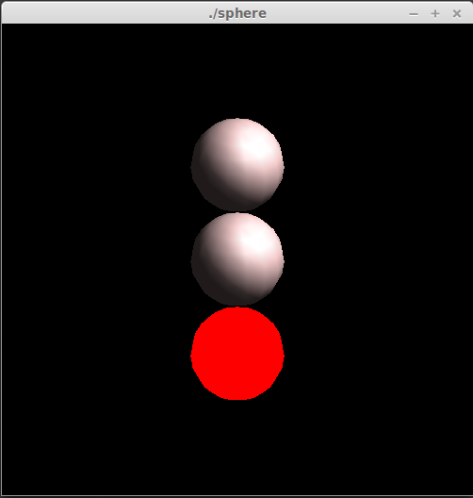
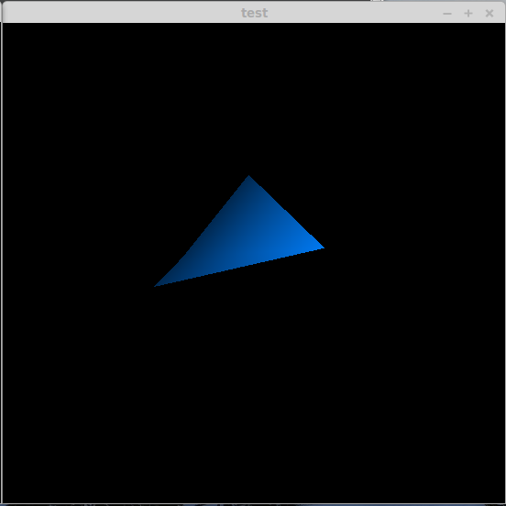
OpenGL – Source Examples
Cube
Sphere
Transform

Slide 7
OpenGL – Dependencies
/demo/packages/install_dependencies.sh
Bash script for Linux environments (via apt-get).
/demo/packages/glew-1.10.0.tgz
Glew installation package for Linux environments.
/demo/packages/jpegsrc.v9a.tar.gz
Jpeg source installation package for Linux environments.
Only required for the ‘Cube’ example.

Slide 8
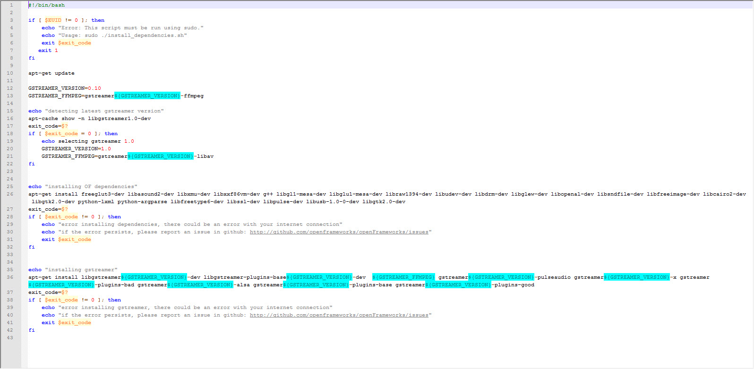
OpenGL – Dependencies
/demo/packages/install_dependencies.sh
Bash script for Linux environments (via apt-get).
Note: Requires sudo permissions!
Note: Installation packages are listed accordingly.

Slide 9
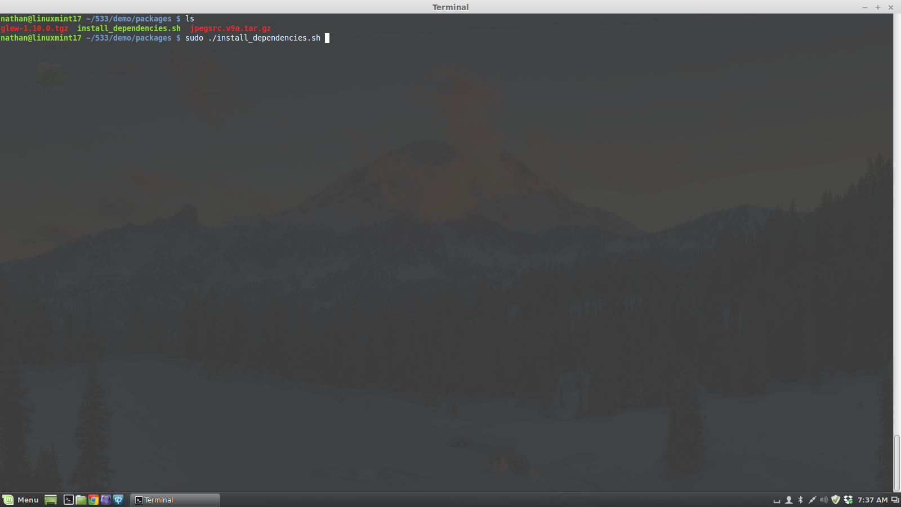
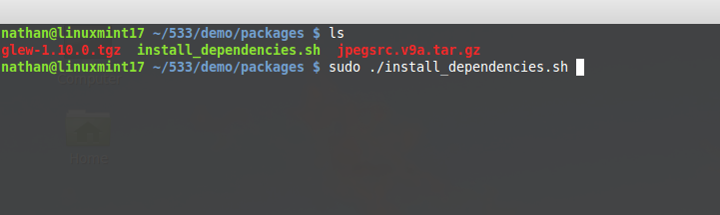
OpenGL – Dependencies
/demo/packages/install_dependencies.sh
Bash script for Linux environments (via apt-get).
Note: Requires sudo permissions!

Slide 10
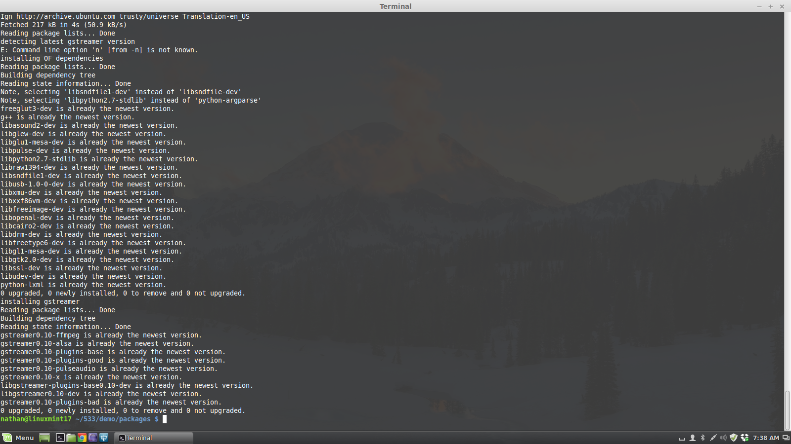
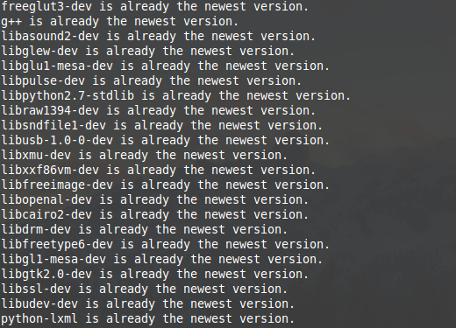
OpenGL – Dependencies
/demo/packages/install_dependencies.sh
Bash script for Linux environments (via apt-get).
Note: If run twice, you should see ‘already the newest version’ for the listed packages.

Slide 11
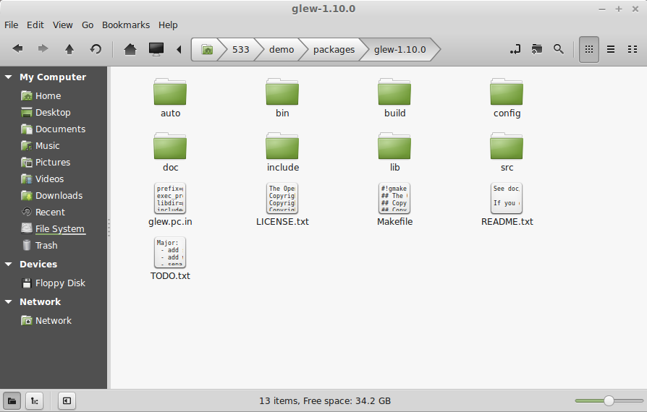
OpenGL – Dependencies
/demo/packages/glew-1.10.0.tgz
Glew installation package for Linux environments.

Slide 12
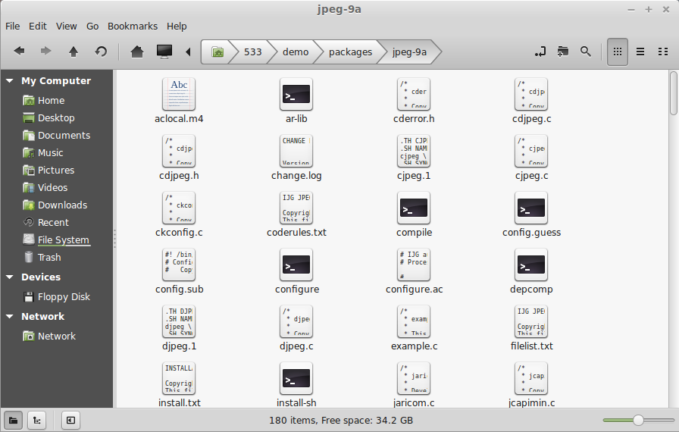
OpenGL – Dependencies
/demo/packages/jpegsrc.v9a.tar.gz
Jpeg source installation package for Linux environments (only required for the ‘Cube’ example).

Slide 13
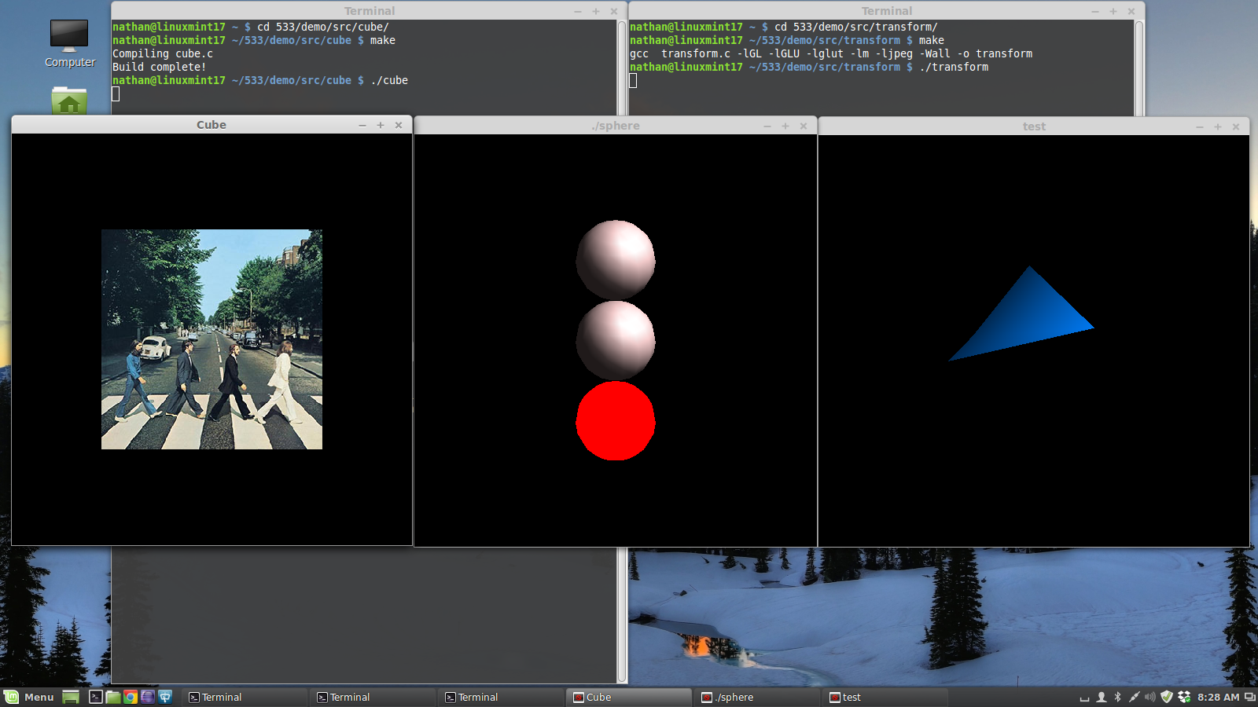
OpenGL on a Local Machine/Virtual Machine
Purpose: Developing/Testing
Rendering: Awesome ☺
Note: The ‘Cube’ and ‘Transform’ source examples both involve animation. Running either example on your LM/VM allows you to get a sense of how the OpenGL pipeline can perform on your accelerated graphics hardware, prior to testing across an ssh/X11 connection.

Slide 14
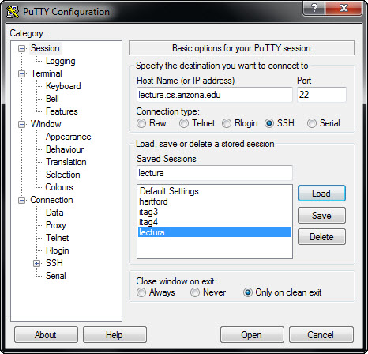
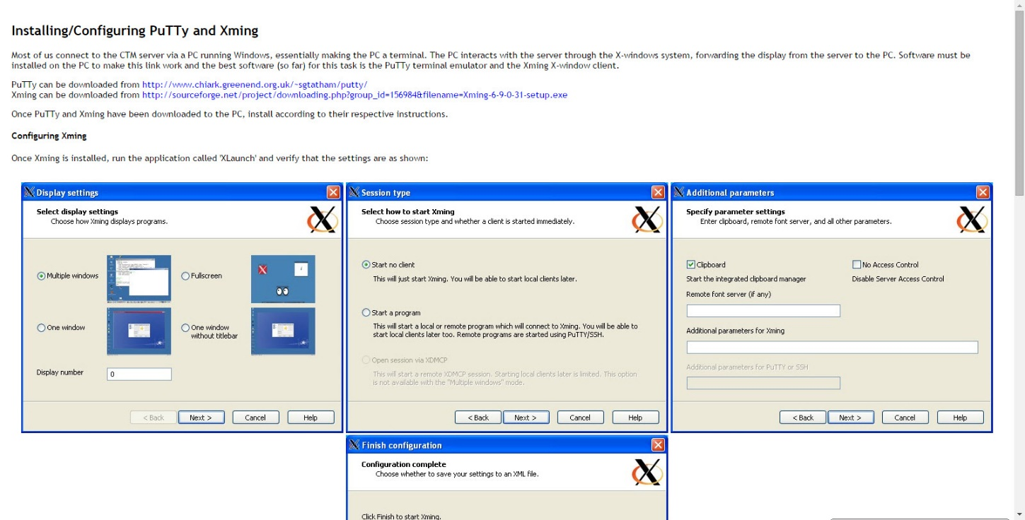
OpenGL on Lectura via PuTTY/Xming
Purpose: Testing/Turnin
Rendering: Not so awesome ☹
Reference:
http://www.geo.mtu.edu/geoschem/docs/putty_install.html

Slide 15
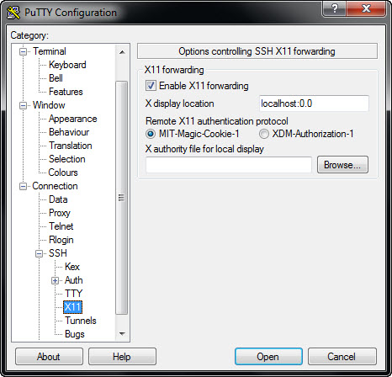
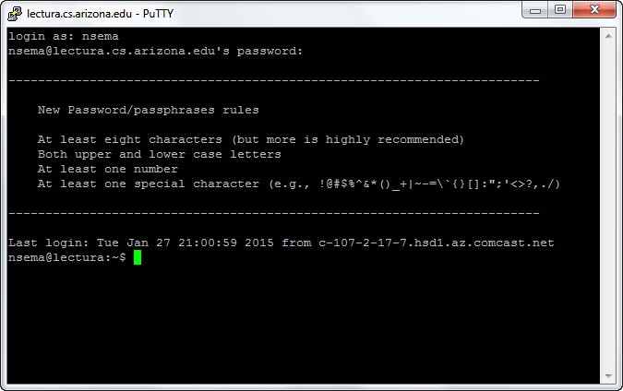
OpenGL on Lectura via PuTTY/Xming

Slide 16
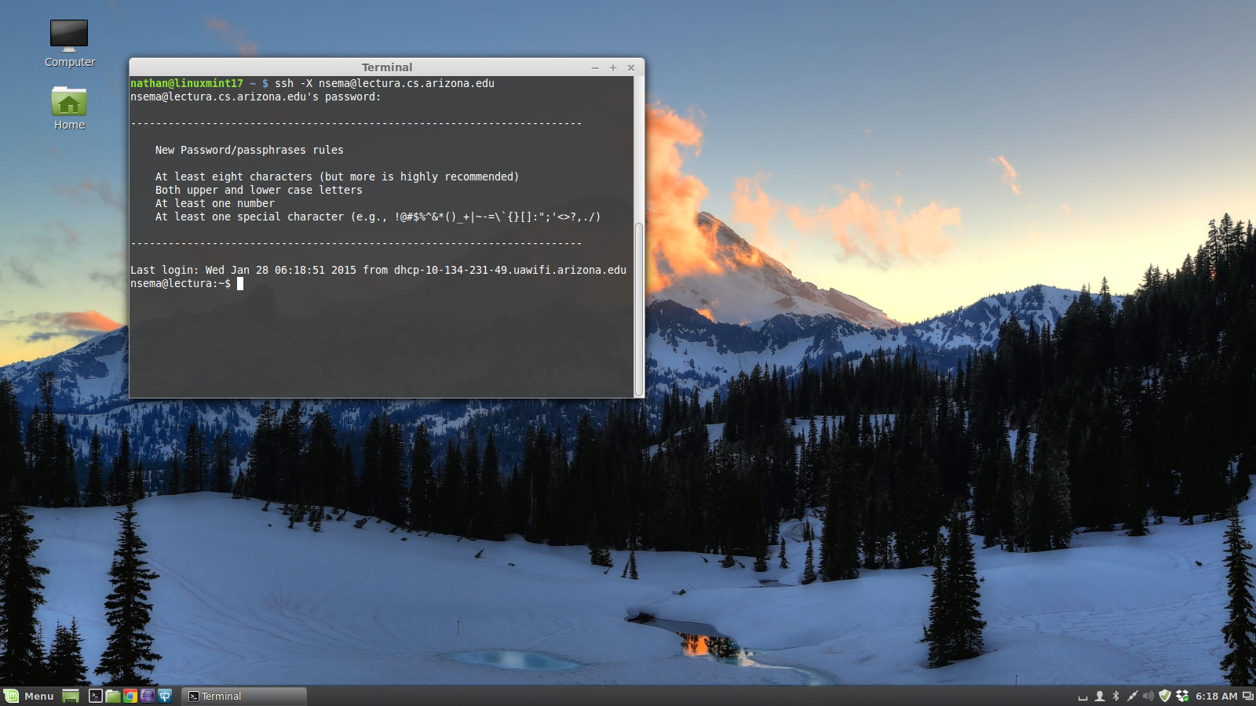
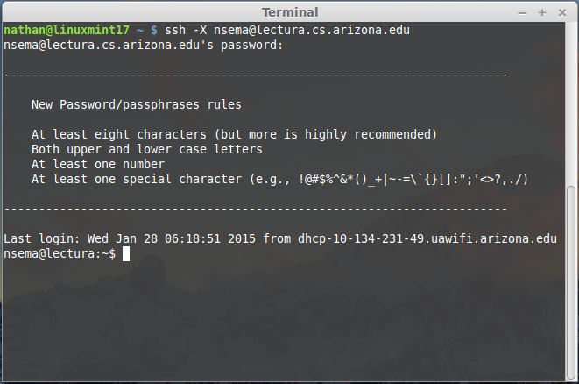
OpenGL on Lectura via ssh
Purpose: Testing/Turnin
Rendering: Not so awesome ☹

Slide 17
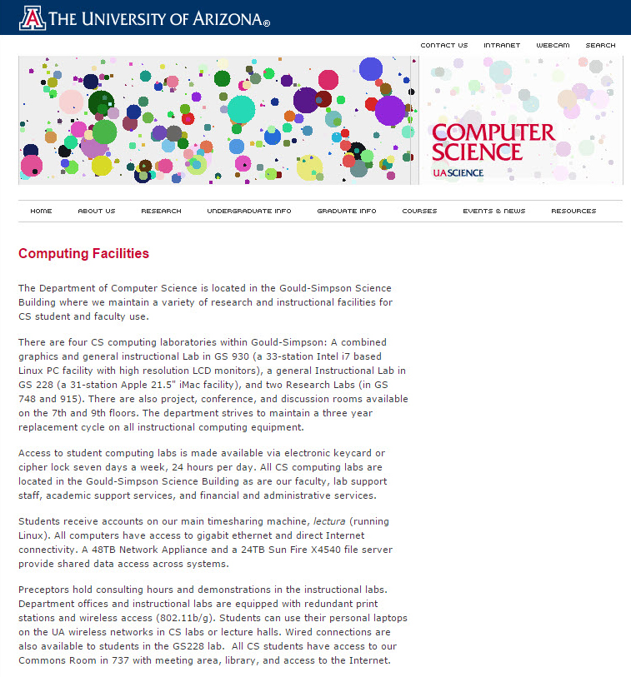
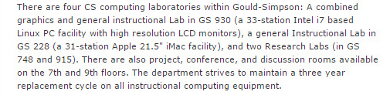
OpenGL on a CS Lab Machine
Purpose: Developing/Testing/Turnin
Rendering: Awesome ☺
Reference:
http://www.cs.arizona.edu/computing/facilities/

Slide 18
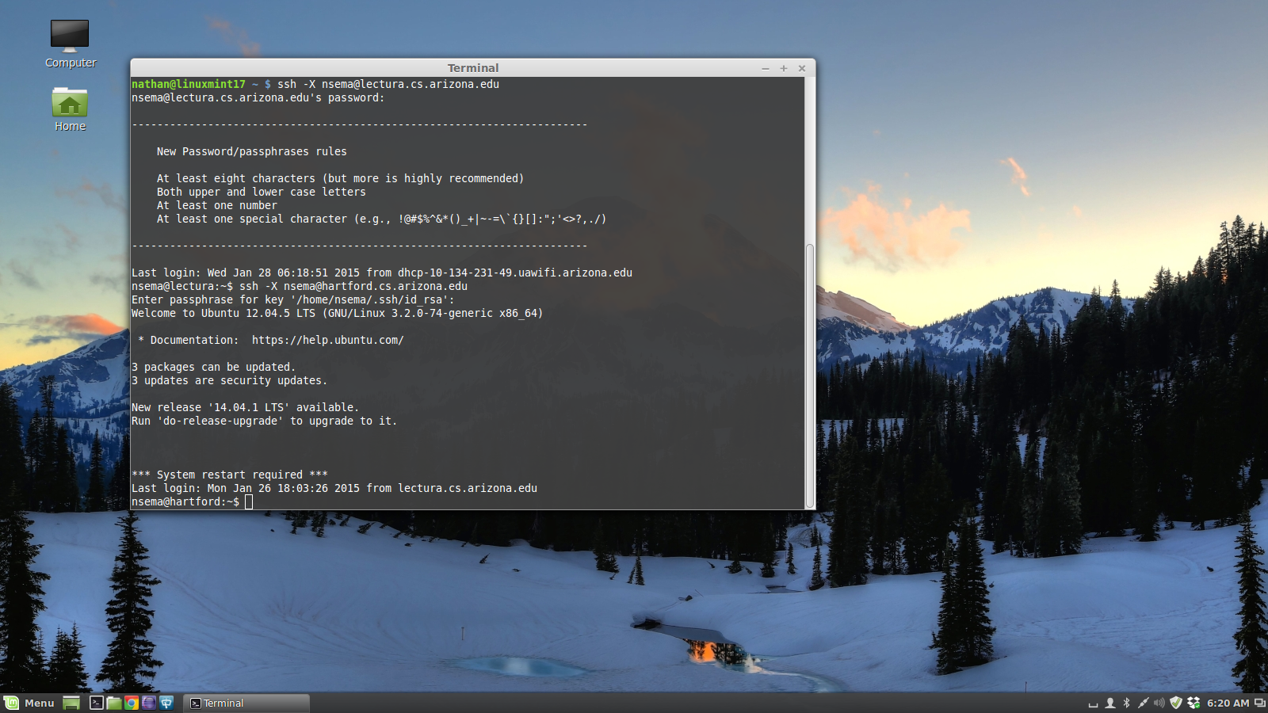
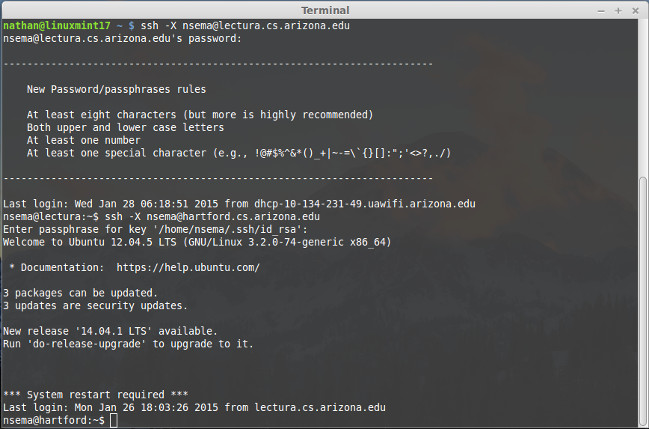
OpenGL on a CS Lab Machine via ssh
Purpose: Testing/Turnin
Rendering: Sort of awesome 😐
Note: If you’ve generated an ssh public/private key pair via ‘ssh-keygen’ on the GS 930 lab machine you are logging to, you’ll be prompted to enter this passphrase (shown in diagram), otherwise you’ll be prompted to enter a cs/lectura password.

